Slide 1
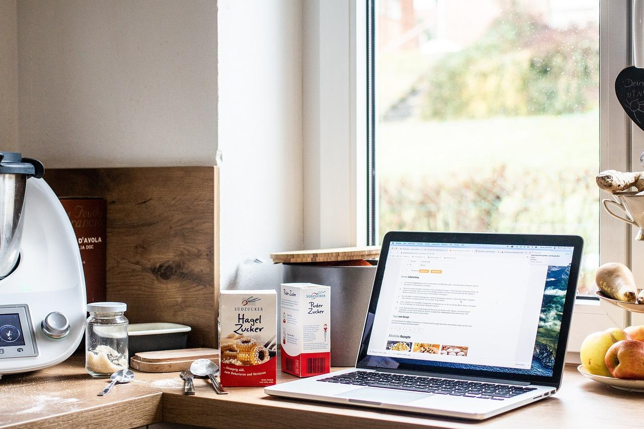
Recipe Scaler
An app that modifies recipe measurements based on user input
BY: NECHAMA WILHELM

Slide 2
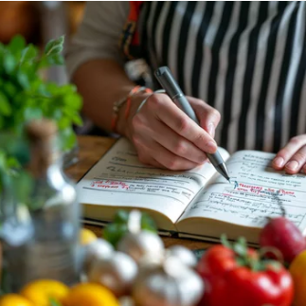
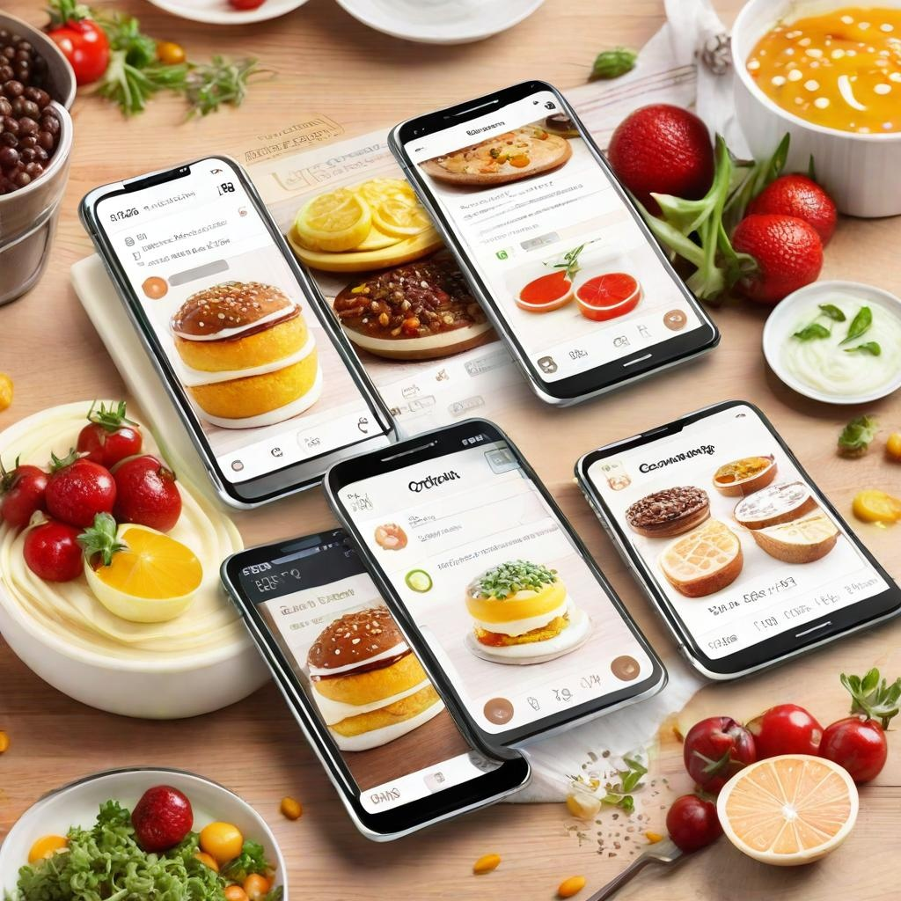
How It Works
Take a picture of the recipe
Upload the picture to the app
Select the desired modifications for the measurements
Access the new recipe measurements

Slide 3
Core Technologies and Tools
Optical Character Recognition (OCR)
Model: ‘Microsoft/Florence-2-large’ from huggingface
Language Model (LLM)
Model: Llama 3.1
Purpose: processing user inputs and providing recipe modifications
User Interface (UI)
Platform: Gradio
Purpose: Intuitive interface for uploading images, selecting modifications, and viewing results
Purpose: Accurate text extraction from recipe image

Slide 4
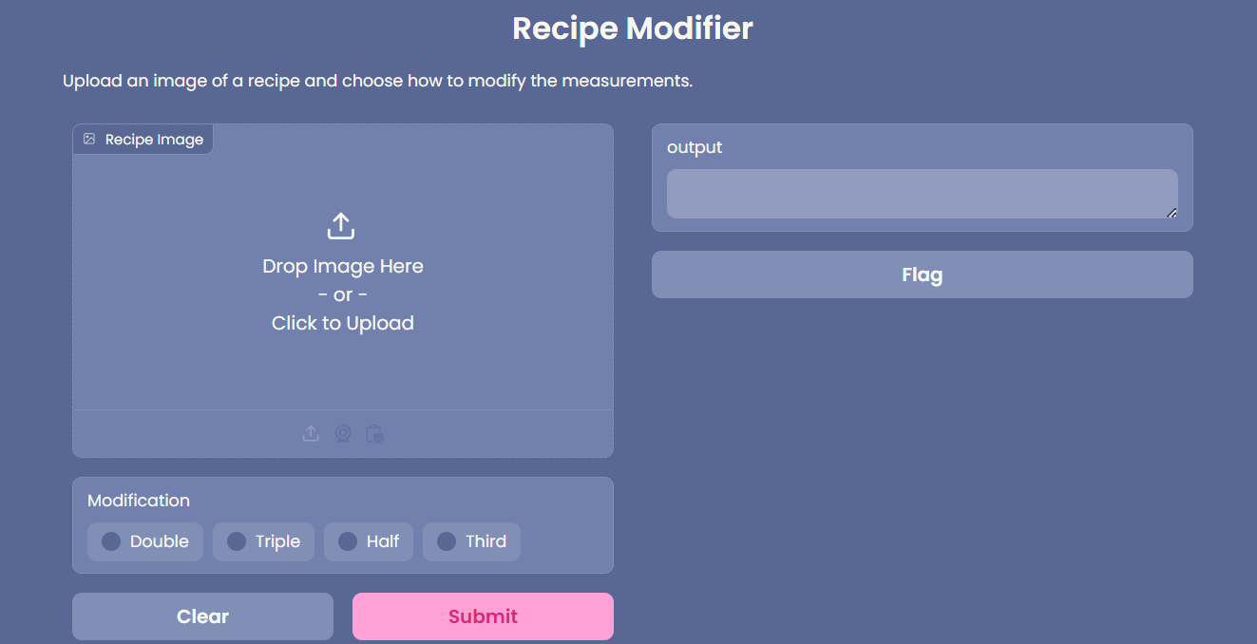
USER INTERFACE

Slide 5
BENEFITS
Save time and effort in manually modifying recipe measurements
Accurate and consistent measurement modifications
Easy to use interface
Ability to modify measurements for any recipe

Slide 6
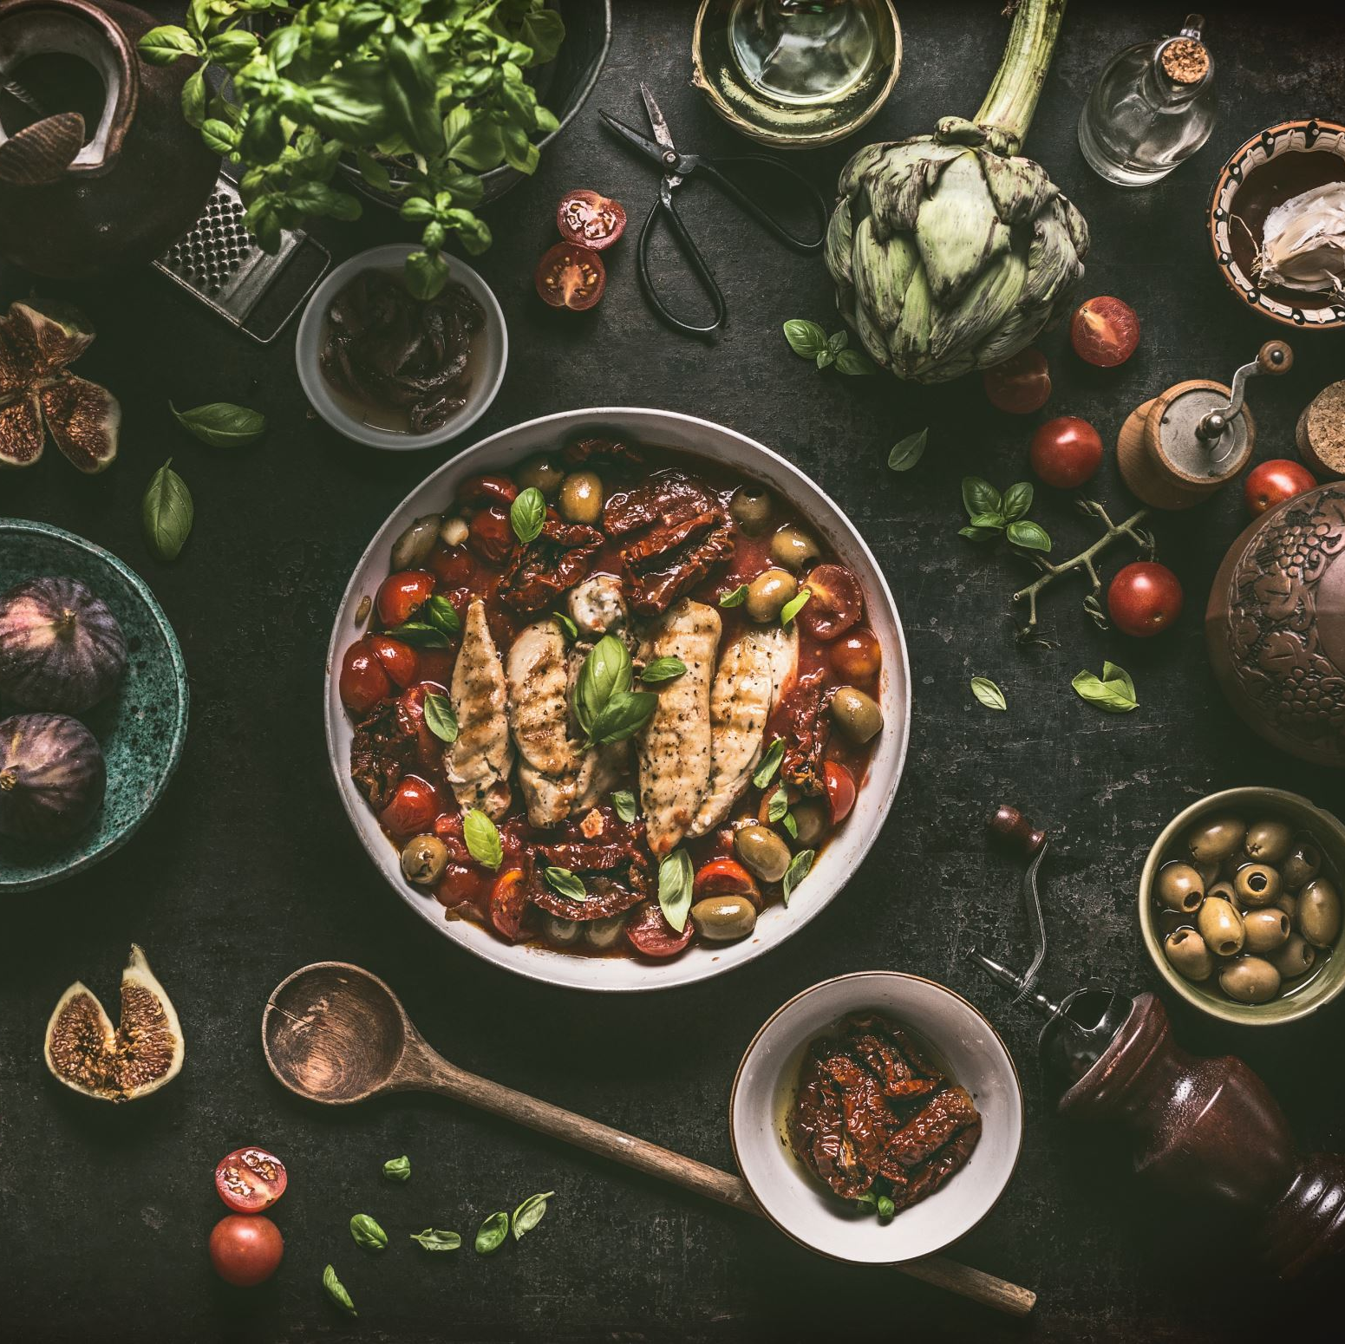
LIMITATION
Only supports images uploaded in .jpg format
Handwritten recipes not be accurately interpreted
Recipes written in columns may not have ingredients in order

Slide 7
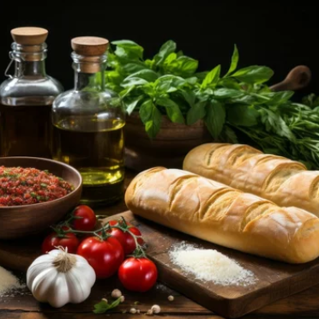
FUTURE ENHANCEMENTS
Expanded File Format Support
Upload additional formats like PNG, BMP, TIFF
Ingredient Substitution
Substitute ingredients for dietary preferences or restrictions (gluten-free, vegan, low-sugar)
Serving Size Adjustments
Specify servings and adjust measurements accordingly

Slide 8

THANK YOU

